Slide 1


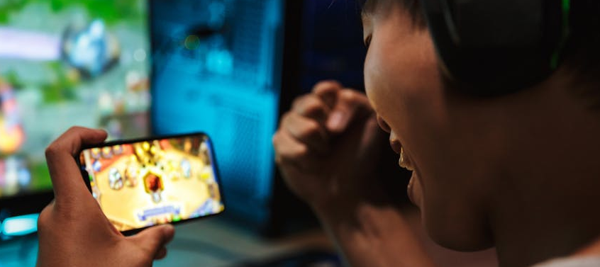

Behavioral Health Barometer
Wood County Youth
Indicators as measured through the 2022 ADAMHS
Youth Survey on Addiction and Mental Health
2022
William J. Ivoska, Ph.D.

Slide 2


ATOD Summary
Increases
  Caffeinated Energy Drinks
  Narcotic painkillers
  Marijuana edibles
Decreases
  Cigarettes
  Vaping
  Alcohol
  Marijuana use – 30 day
  Cough medicine
  Anxiety/Sleep drugs
  Inhalants

Slide 3
Behavioral Health Summary
Increasing
  Overall Mental Health Problems
  Bullying among 5th and 6th graders
  Suicide Ideation & Attempts
  ACEs
  Gambling & Gaming
Decreasing
  Fear of Harm from marijuana

Slide 4

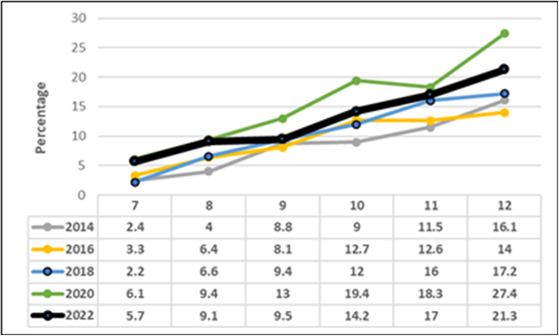
Vaping Past 30-Days
Chart goes here

Slide 5
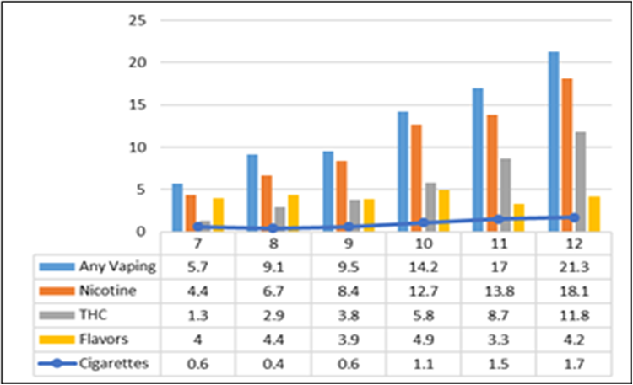
Vaping Past 30-Days – Vape Device Content
Chart goes here

Slide 6
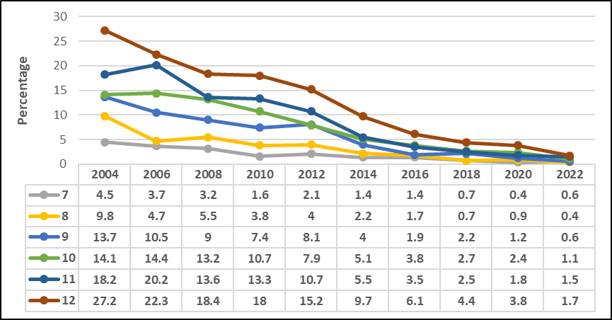

Cigarette Use - Past 30-Days

Slide 7
Vaping Past 30-Days – Vape Device Content
Chart goes here

Slide 8
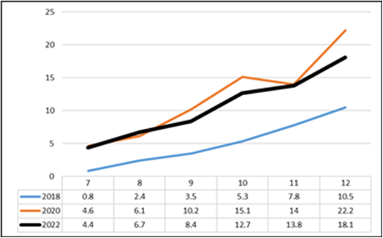
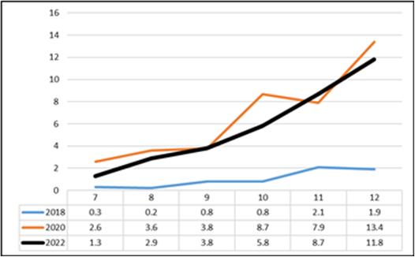
Vaping: Nicotine & Marijuana
Nicotine
Marijuana

Slide 9
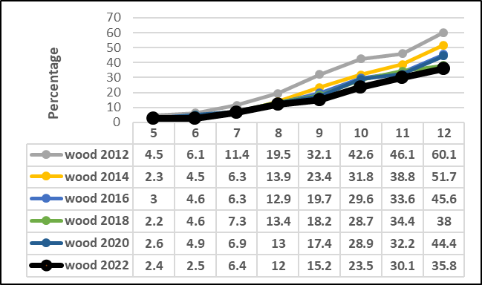
Alcohol Last Year
Chart goes here

Slide 10
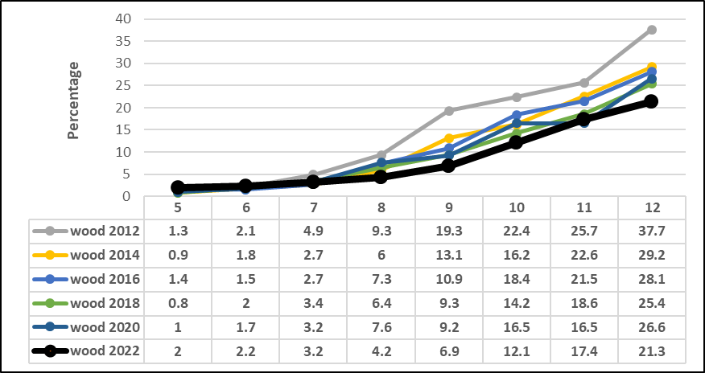

Drinking Last Month

Slide 11
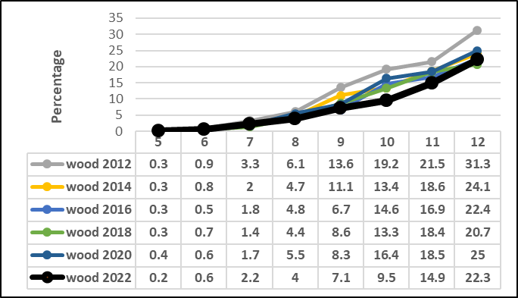
Marijuana Use Last Year

Slide 12
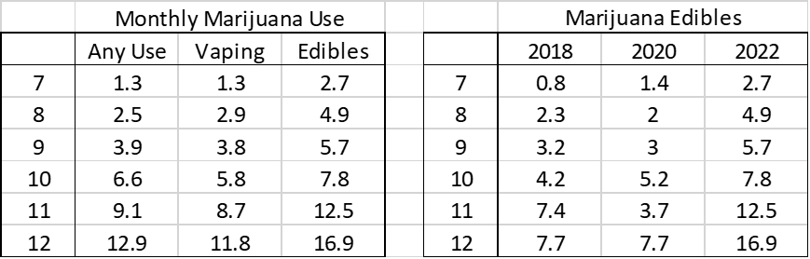
30-Day Marijuana Use by Technique & Gender

Slide 13
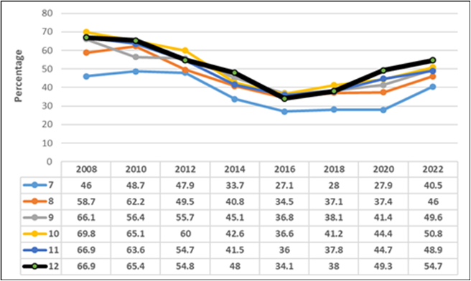
Caffeinated Energy Drinks

Slide 14

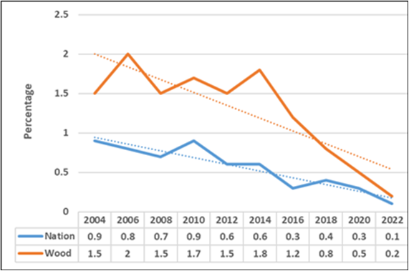
Heroin

Slide 15
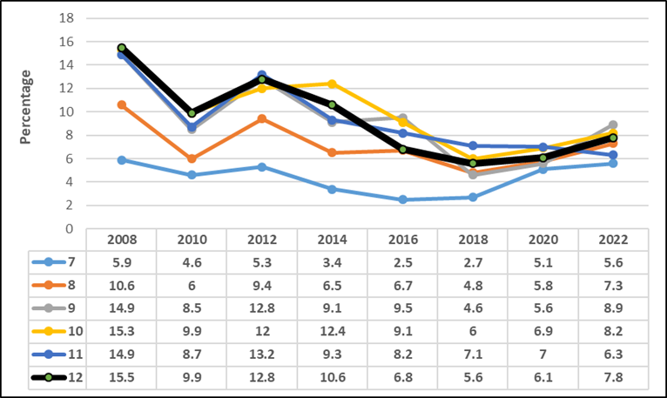
Painkillers (30-day)

Slide 16

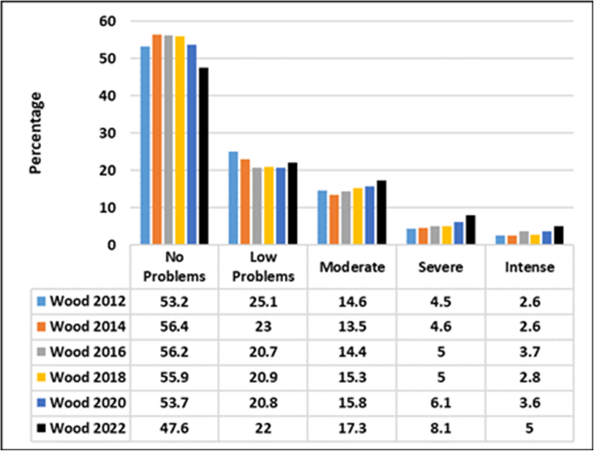

Youth Mental Health
Severe & Intense:
2018 = 7.8%
2020 = 9.7%
2022 = 13.1%

Slide 17

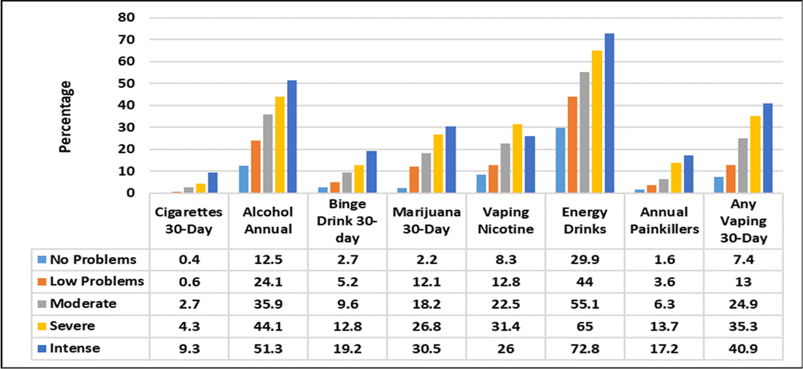
Mental Health and Substance Abuse
Chart goes here

Slide 18
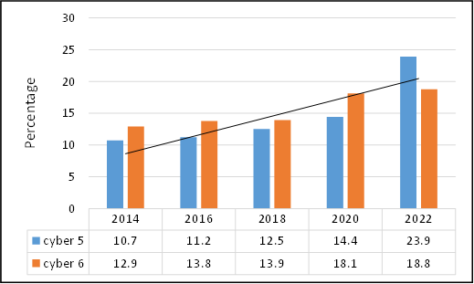
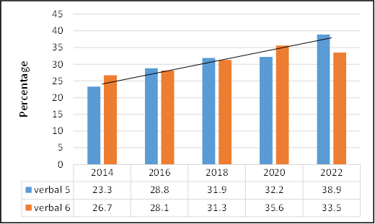
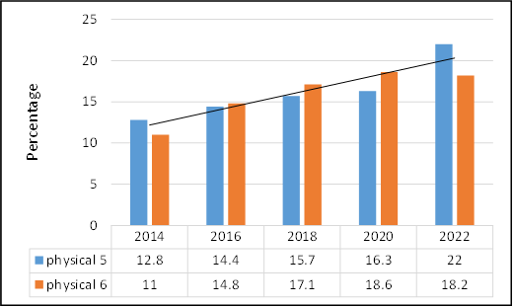
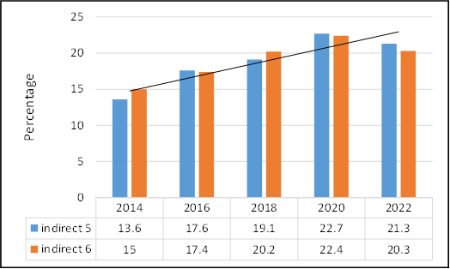
Bullying: 5th and 6th Graders

Slide 19
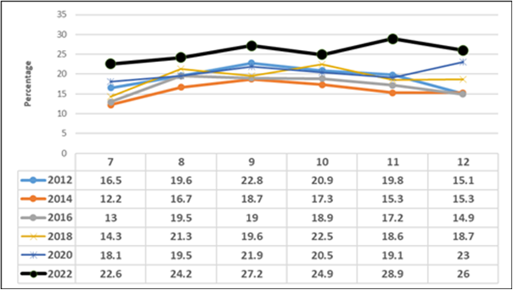
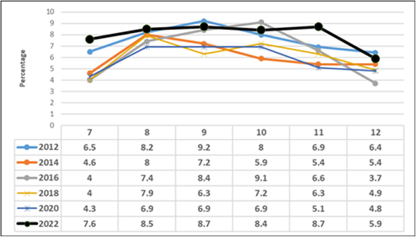
Suicide: Ideation and Attempts
All GRADES REPORTED THE HIGHEST RATE OF SUICIDE IDEATION EVER RECORDED IN THE ADAMHS YOUTH SURVEY
SUICIDE ATTEMPTS TRENDED UPWARD

Slide 20
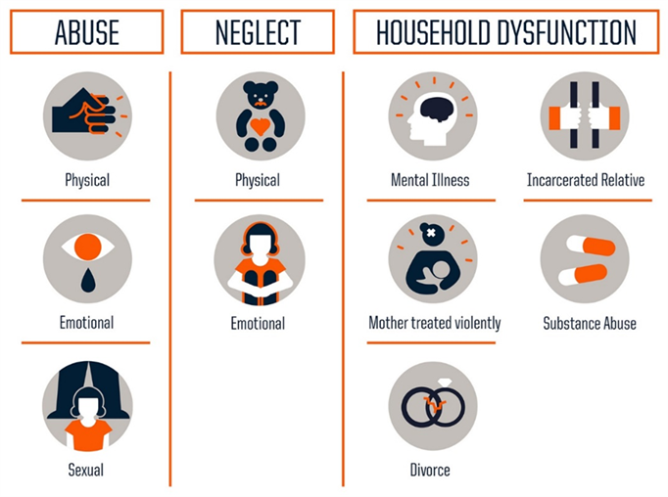
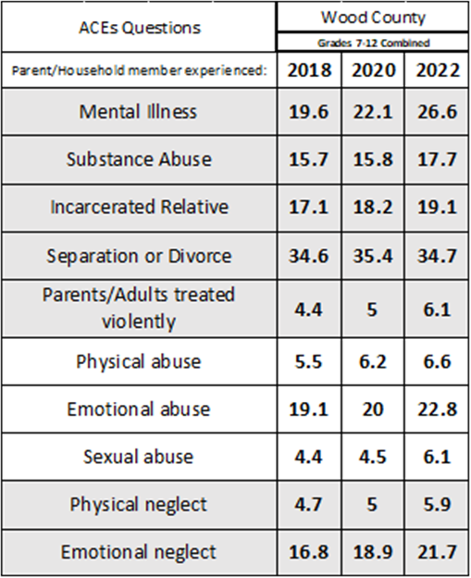
ACEs

Slide 21
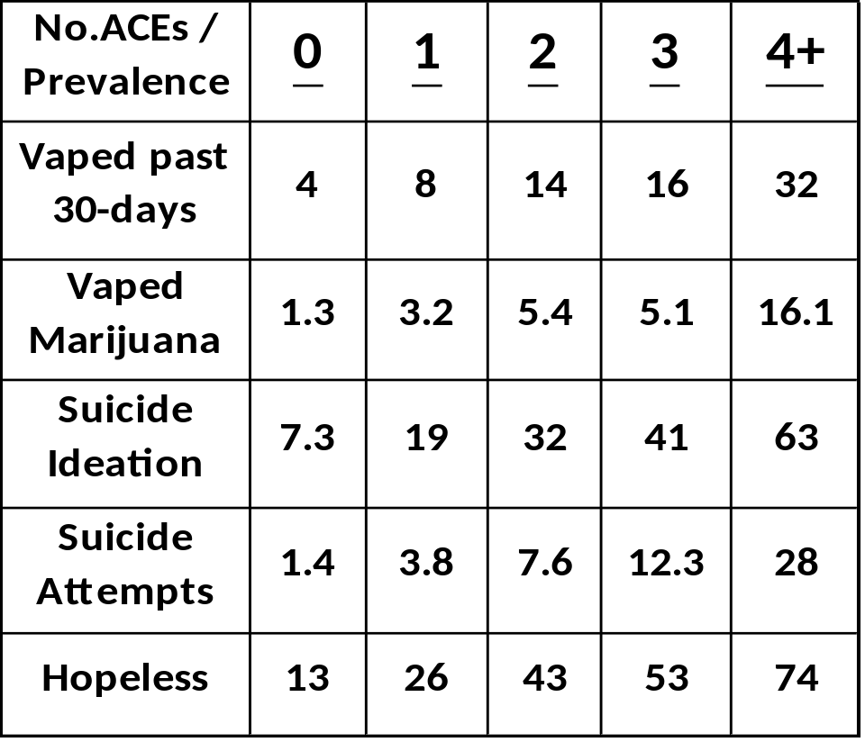
ACEs
As the number of ACEs increase, so does the percentage of at-risk behaviors.

Slide 22

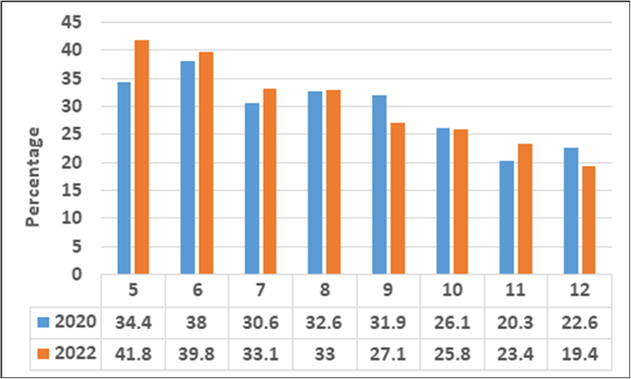
Adolescent ‘Gaming’
Gaming activity is any gaming-related activity that has been played either from a computer/lap-top or from a gaming console or any other kind of device (phone, tablet) on or offline

Slide 23
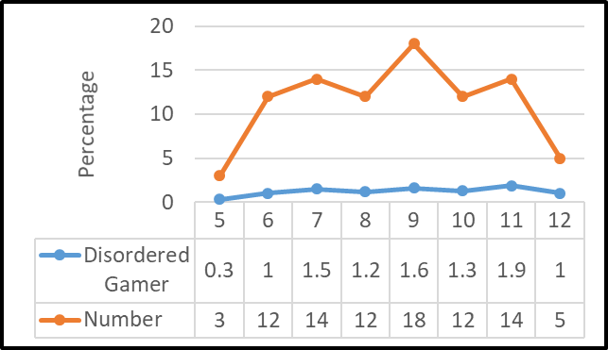
Adolescent ‘Gaming’
Teens took an Gaming Disorder Test (Pontes, 2019) – Problem gaming rates were low

Slide 24
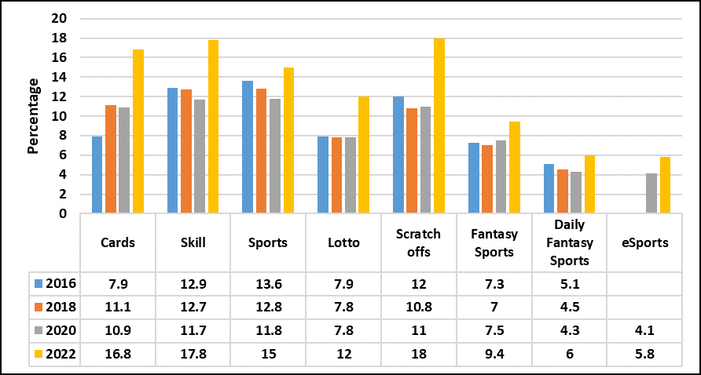
Adolescent ‘Gambling’ 7th-12th grade combined

Slide 25
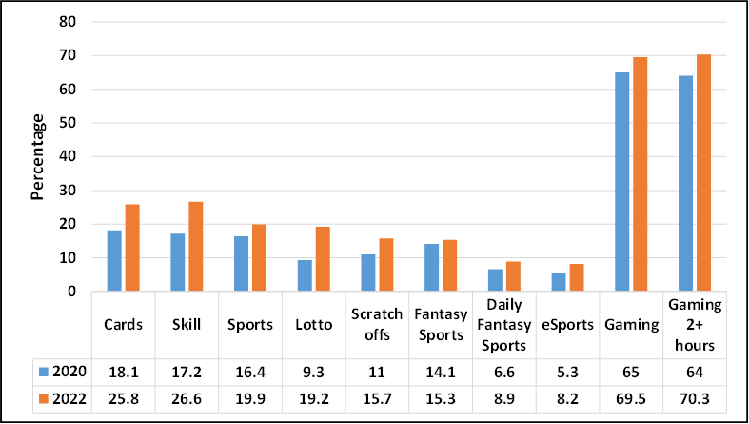
Adolescent ‘Gambling’ – 11th & 12th grade males
Teens took a Problem Gambling Scale– Problem gambling rates increased from 2.7% in 2020 to
6.7% in 2022

Slide 26
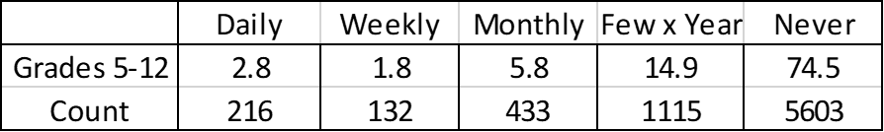
Adolescent ‘Game-bling’
Have you ever spent money on Loot boxes in a game?

Slide 27
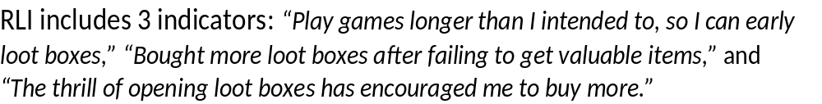
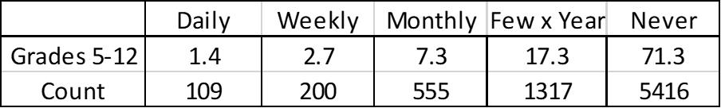
Adolescent ‘Game-bling’
Risky Loot Box Inventory (RLI) Indicators?

Slide 28
Adolescent ‘Gambling’ & Gaming
Teens took the Preference for a Virtual Life (PVL)Scale (Peng & Liu, 2010) :
1. “I am a more valuable person in the online game world than in real life”
2. “I am more respected in the online game world than in real life”
3. “ I prefer communicating with other people in the online game world rather than face-to-face.”

Slide 29
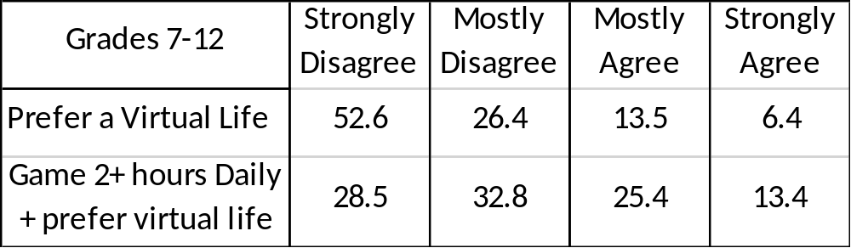
Adolescent ‘Gambling’ & Gaming
Percentage of Teens who agreed with the PVL items

Slide 30



ATOD Prevalence 2020-2022
Grades 7-12 combined
47.7% | Caffeinated Energy Drinks
18.4% | Alcohol
11.7% | Vaping (30-day)
8.6% | Marijuana
7.0% | Cough Medicine
5.6% | Benzos
4.3% | Painkillers (30-day)
2.5% | Methylphenidate
1.9% | Inhalants
1.2% | LSD
.9% | Cigarettes
<1% | All Other Drugs

Slide 31

Vaping Past 30-Days – Vape Device Content
No Nic
Yes Nic

Slide 32
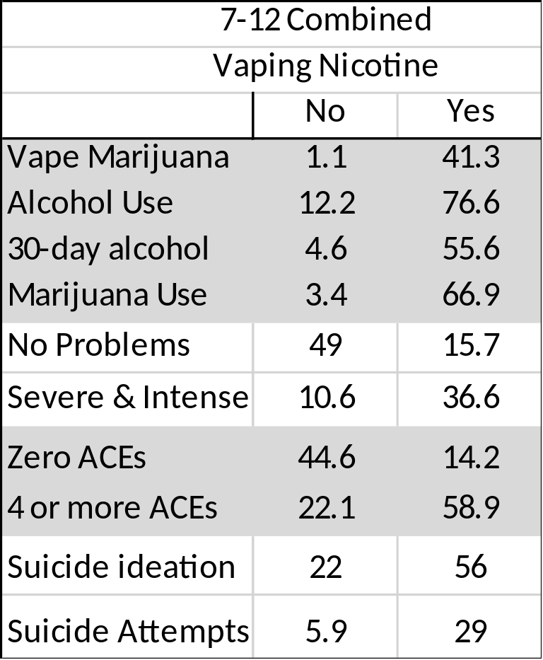
Vaping Nicotine Past 30-Days

Slide 33
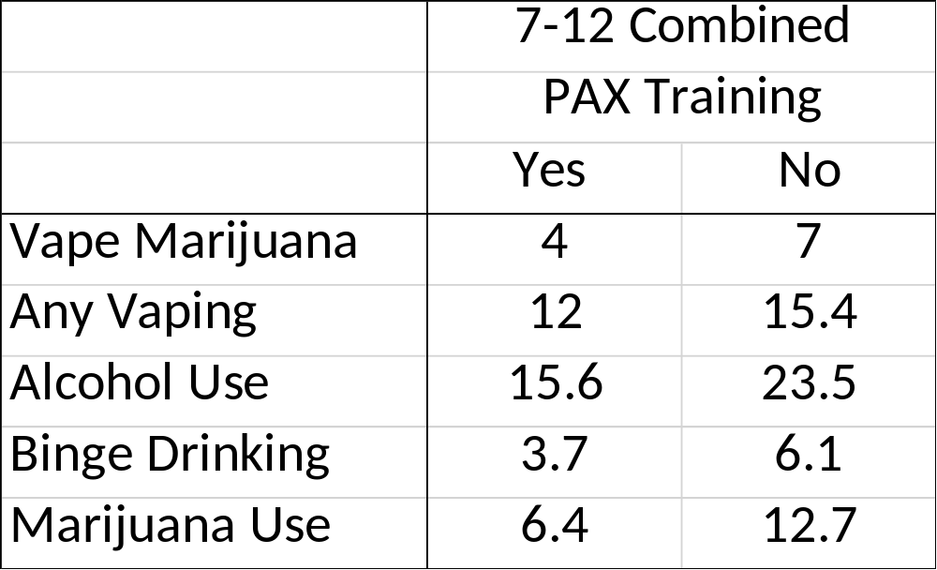
PAX Training

